Slide 1

EART60702 Earth & Environmental Data Science Project 1
Madeleine Carnell
Chenyu Ma
Cameron Meekums-Spence
Wanglu Yu

Slide 2
Aim
Explore relationships between variables
How are the variables changing over time
Preprocessing of data
Guage a picture of where the data is from
What is the data telling us

Slide 3
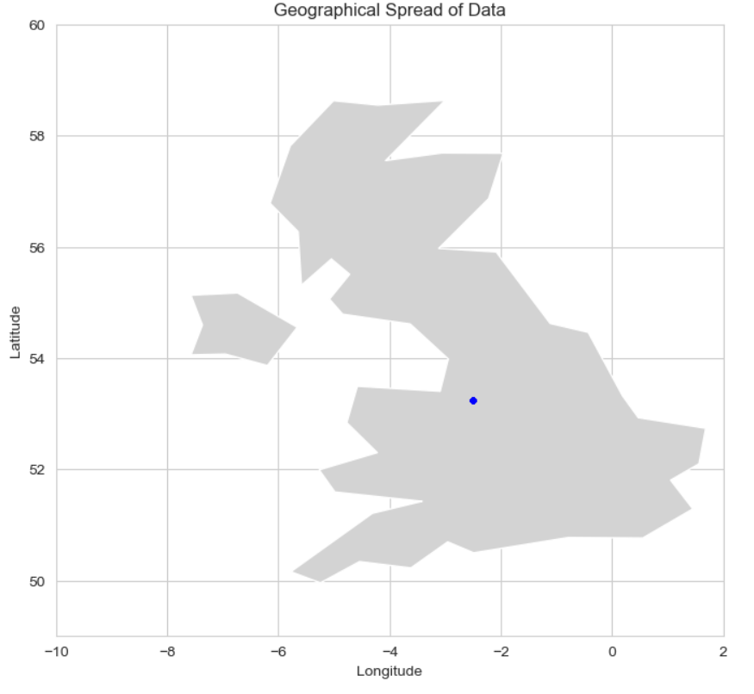
About The Data
Field Name | Long Name | Units
TREFMXAV_U | Daily Maximum of Average Temperature | K
FLNS | Net Longwave Flux at Surface | W/m^2
FSNS | Net Solar Flux at Surface | W/m^2
PRECT | Total(convective and large-scale) Precipitation Rate(liq) | m/s
PRSN | Snow Precipitation Rate | m/s
QBOT | Lowest Model level water vapor mixing ratio (Humidity) | Kg/kg
TREFHT | Reference Height Temperature | K
UBOT | Lowest Model Level Zonal Wind | m/s
VBOT | Lowest Model Level Meridional Wind | m/s
Lat/Lon | Latitude / Longitude coordinates | n/a
Geographical data covering several variables over weather and location
All data confined to a single coordinate, approximate to Manchester, UK
Notes:
Data has all come from Zhonghua Zheng’s webpage
Most data meanings available online at NSF website apart from PRSN. There are several different applications of PRSN online so we decided to go with Snow Precipitation Rate m/s as this made the most sense
The data reflects a single Geographic coordinate approximate to Manchester. The data needed preprocessing to properly establish this which will be talked about briefly later in the presentation
The data covers many variables that represent temperature, precipitation, wind, solar and longwave radiation

Slide 4
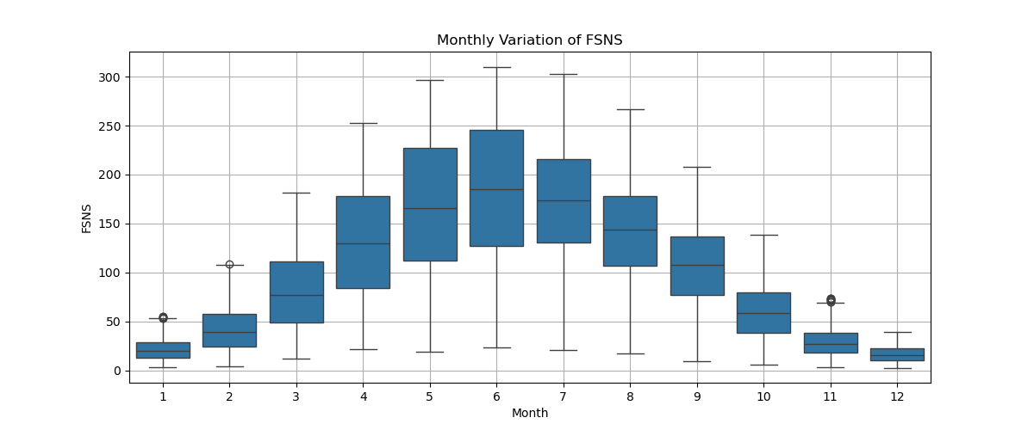
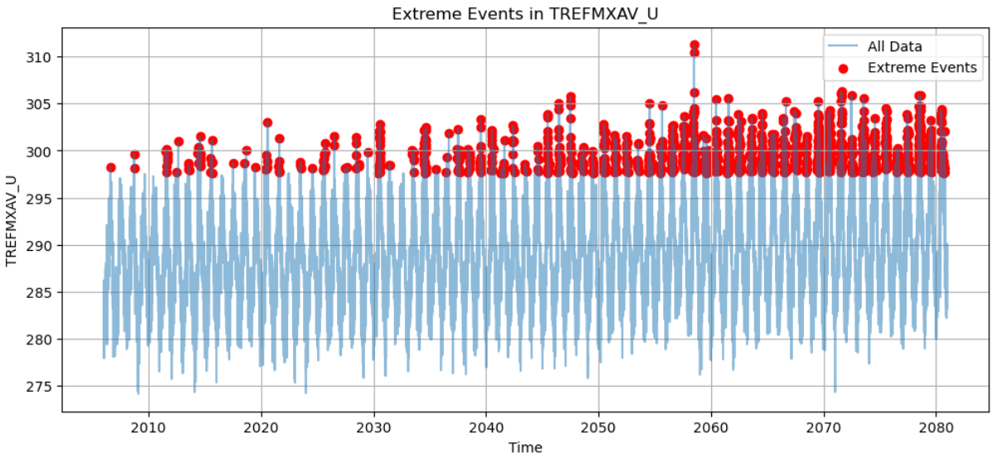
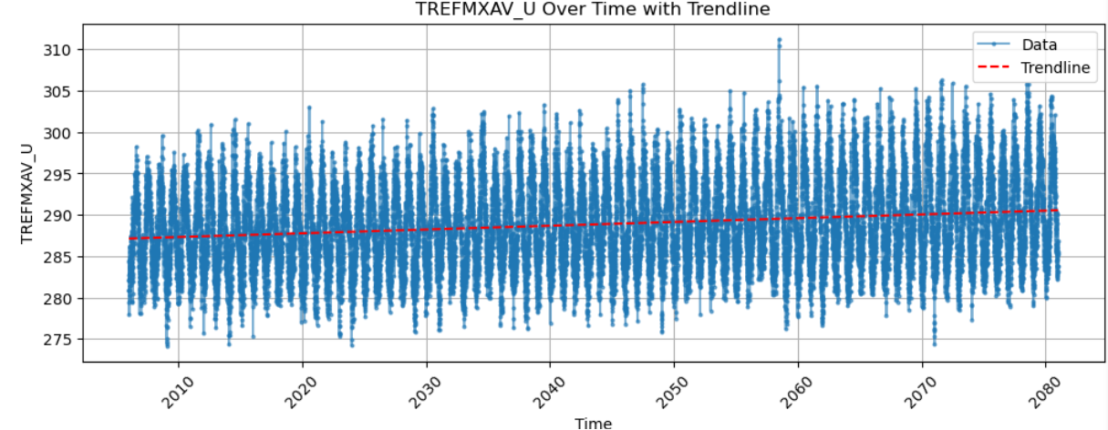
Initial EDA
Carried out on unprocessed data to help inform next steps
Temperature increasing over time
More extreme weather events over time with temperature
Drastic increase in solar flux over Spring & Summer months

Slide 5
Preprocessing
Raw Field | Raw Units | Processed Name | Processed Unit | Changes
Time | Date | Time | Date | No change made
TREFMXAV_U | K | Temp_Max_C | ºC | Converted from K to °C
FLNS | W/m^2 | Radiation_Longwave_(W/m²) | W/m^2 | No change made
FSNS | W/m^2 | Radiation_Shortwave_(W/m²) | W/m^2 | No change made
PRECT | m/s | Precipitation_mm_s Precipitation_mm_day | mm/s mm/day | Converted (m/s * 86400000) Converted (m/s * 1000)
PRSN | m/s | Snowfall_mm_s Snowfall_mm_day | mm/s mm/day | Converted (m/s * 86400000) Converted (m/s * 1000)
QBOT | Kg/kg | Humidity_(kg/kg) | Kg/kg
TREFHT | K | Temp_Avg_C | ºC | Converted from K to °C
UBOT | m/s | Wind_U_(m/s) | m/s | No change made
VBOT | m/s | Wind_V_(m/s) | m/s
Lat Lon | -180 to 180 360º | Lat Lon | -180 to 180 -180 to 180 | Longitude converted from 360º format to -180 to 180
No missing Values or Duplicate rows confirmed
Additional time columns extracted (Year, Month, Day, DayOfWeek, Month_Name, and Day_Name)
Negative values in precipitation (1 value) and snowfall (1048 values) columns were identified and replaced with NaN.
These NaN values are then interpolated, replacing missing values smoothly based on surrounding data points.

Slide 6
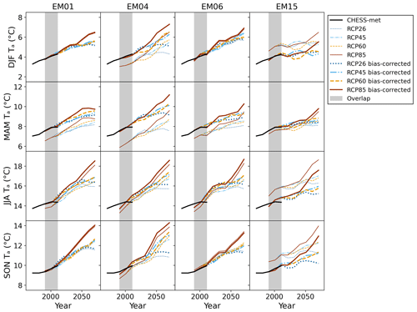
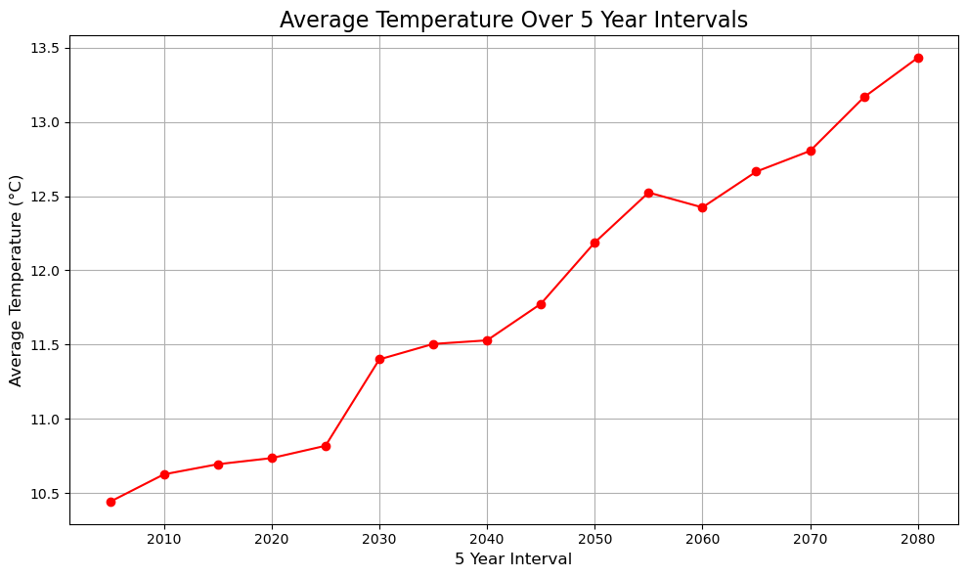
Model
Presents as a Regional Climate Model (RCM), similar to the CHESS-SCAPE Model by the UK Centre for Ecology & Hydrology (CEH).
(Robinson et al., 2023)
Comparison of Temperature predictions from CHESS (above) &provided dataset (left)

Slide 7
Correlations
Distribution of multiple variables
Correlations between variables
Univariate Linear Regression
Multivariate Linear Regression
Notes:
I will be discussing correlation analysis and how it helps us understand relationships between variables. We will explore distributions, correlation matrices, and linear regression models to analyze dependencies.

Slide 8
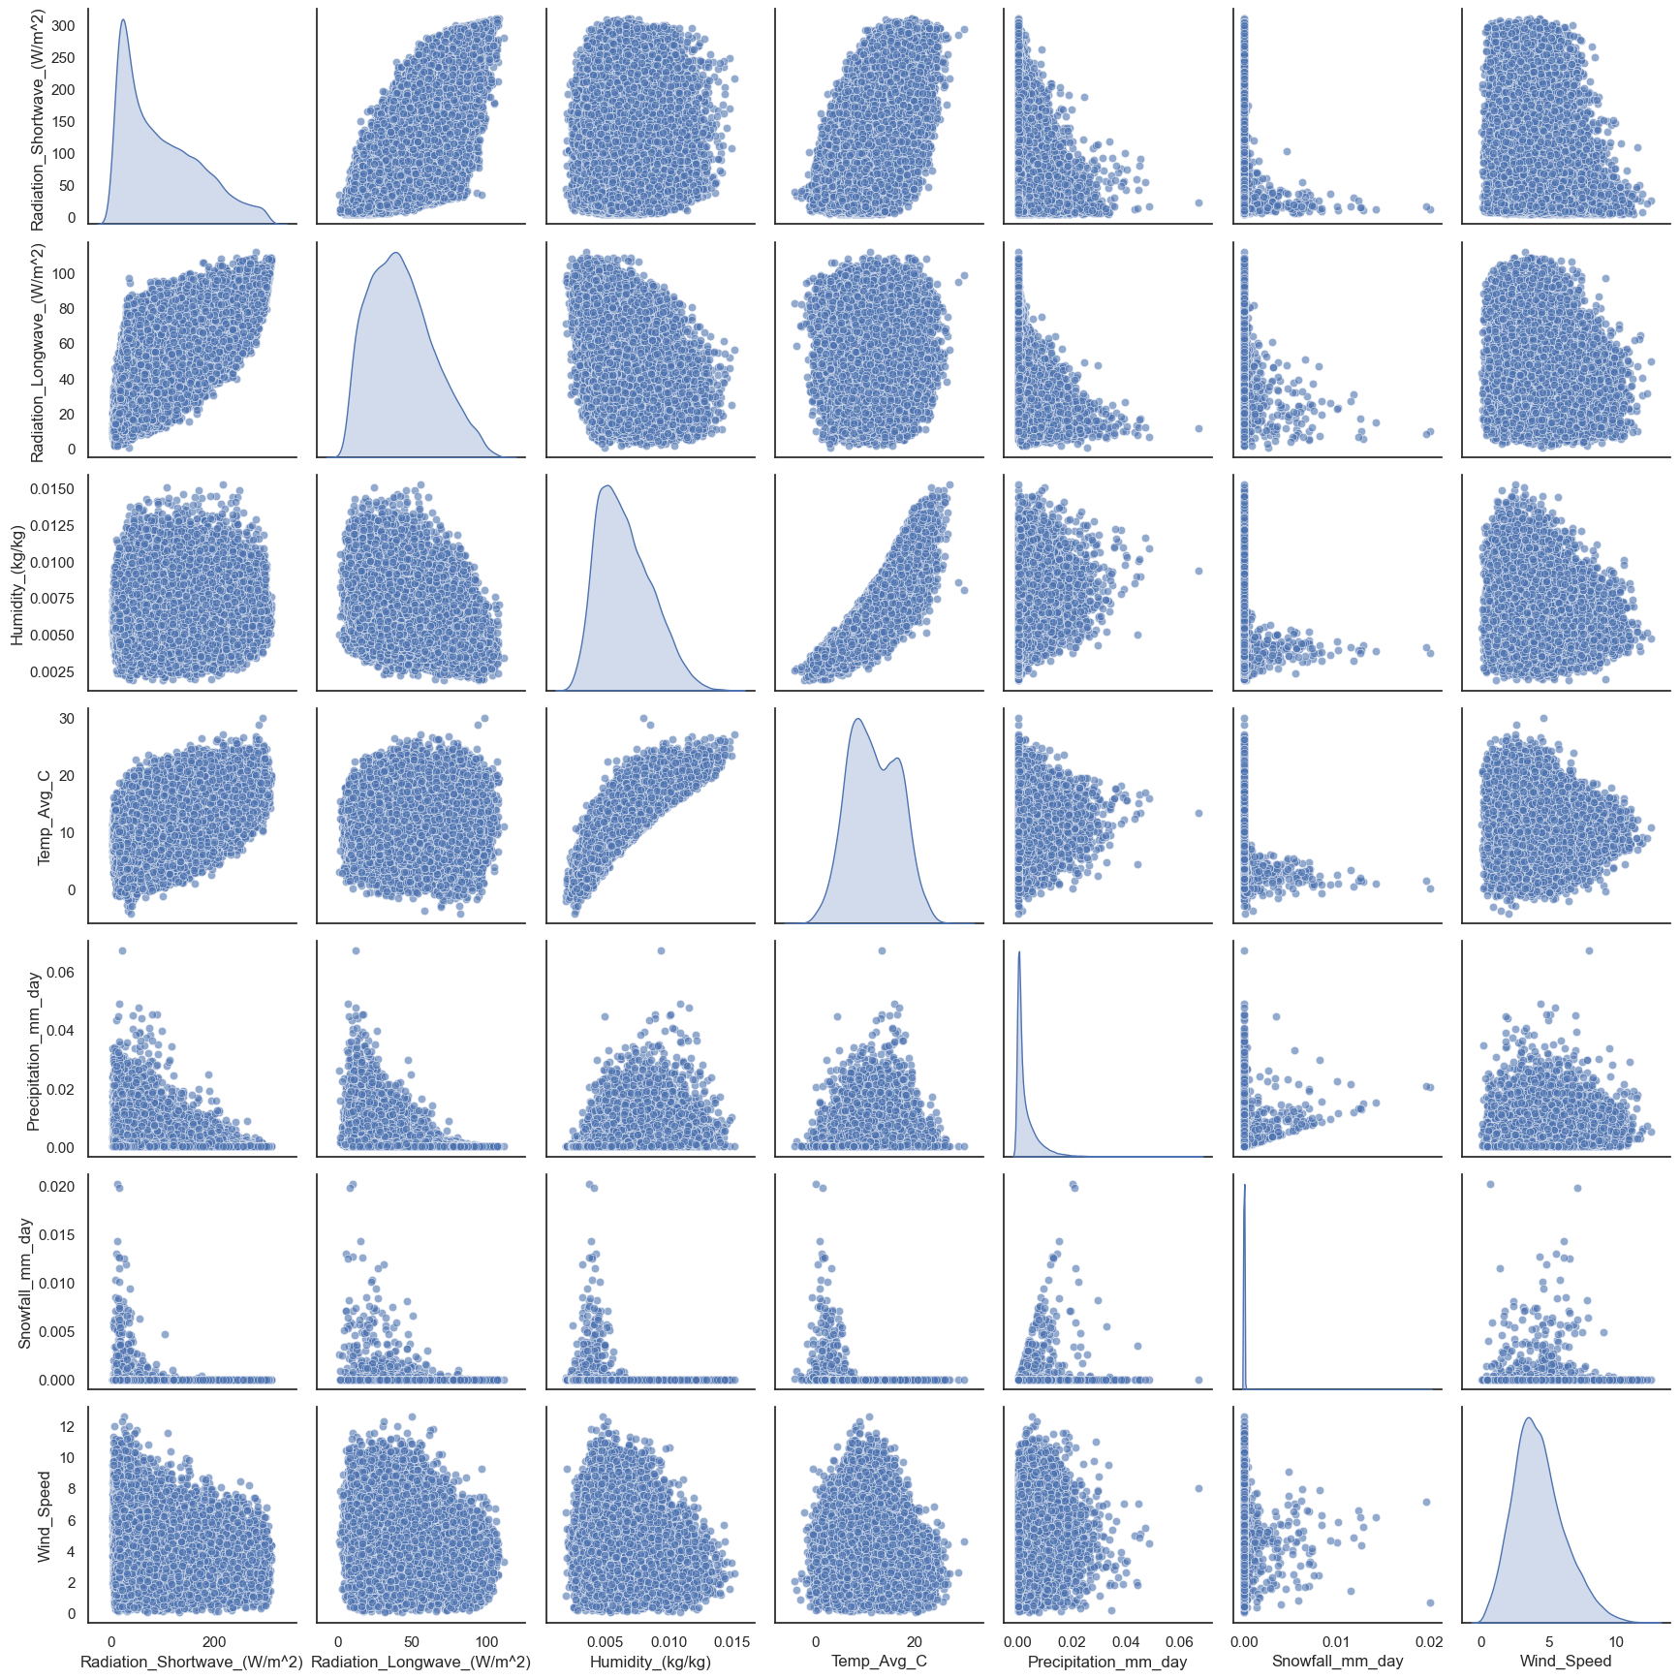
Distribution between Variables
Positively Skewed Distributions
Unimodal Kernel Density Estimates
Positive Correlation with Temperature
Humidity as a Potential Linear Predictor of Temperature
Notes:
we visualize the distribution of multiple variables using scatter plots.
The data exhibits positively skewed distributions
The kernal density plots on the grid's diagonal look fair unimodal, though temperature have a small ripple that one might take as evidence of biomodality.
There is a positive correlation with temperature, meaning some variables increase as temperature increases.
Humidity, in particular, appears to be a potential linear predictor of temperature, which we will analyze further.

Slide 9
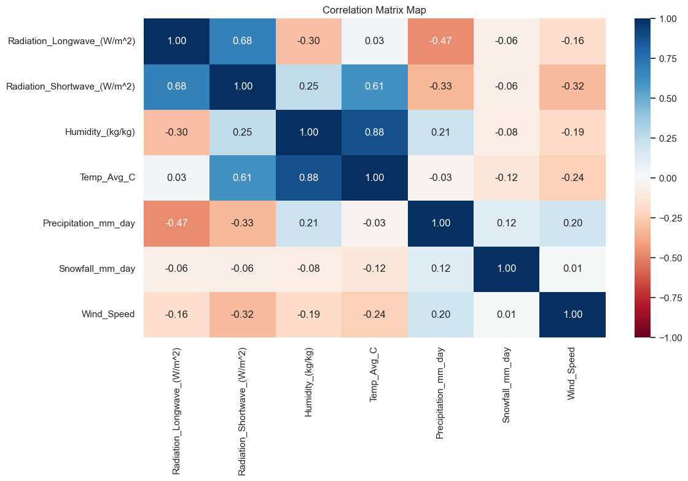
Correlation Matrix
Positive Correlation
Humidity & Temperature
Radiation & Temperature
Shortwave radiation & Longwave radiation
Lack of Strong Negative Correlations
Notes:
This correlation matrix helps us understand the strength and direction of relationships between variables.
We observe positive correlations between several variables.
Importantly, there is a lack of strong negative correlations, which means no significant inverse relationships exist. This visualization helps us identify which factors might be useful for prediction.

Slide 10
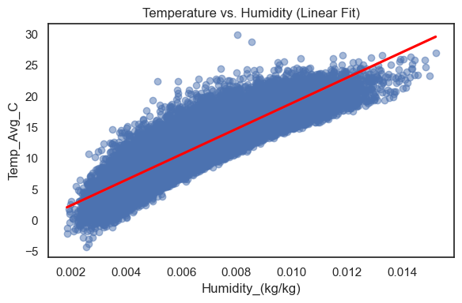
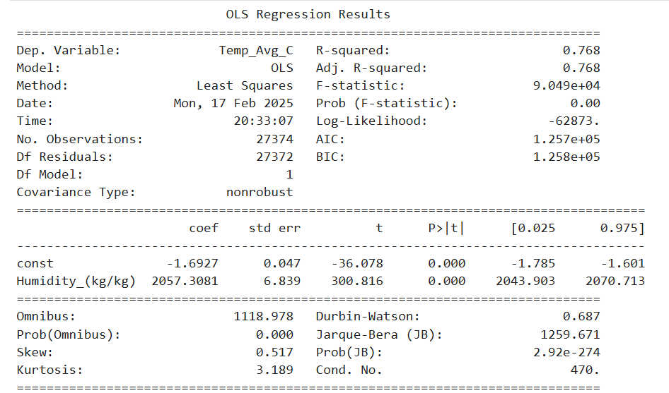
Linear regression of temperature and humidity
Figure. Scatter plot of temperature and humidity
Table. Results of OLS Regression
Notes:
let's analyze the relationship between temperature and humidity using a simple linear regression model.
The scatter plot shows a strong positive relationship.
The regression equation suggests that humidity significantly influences temperature.
The R-squared value is 0.768, indicating that humidity explains about 76.8% of the variation in temperature.

Slide 11
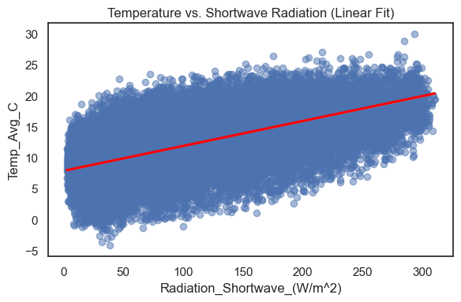
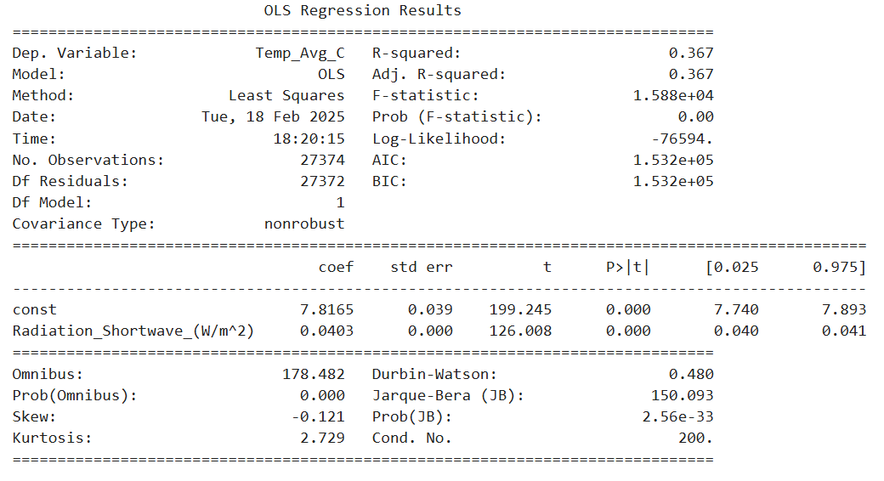
Linear regression of temperature and shortwave radiation
Figure. Scatter plot of temperature and shortwave radiation
Table. Results of OLS Regression
Notes:
Similarly, we examine the relationship between temperature and shortwave radiation.
The scatter plot again shows a positive trend, but the relationship is weaker.
The R-squared value is 0.367, meaning shortwave radiation explains only 36.7% of the temperature variation.
This suggests that while radiation is a factor, it is not as strong a predictor as humidity.

Slide 12
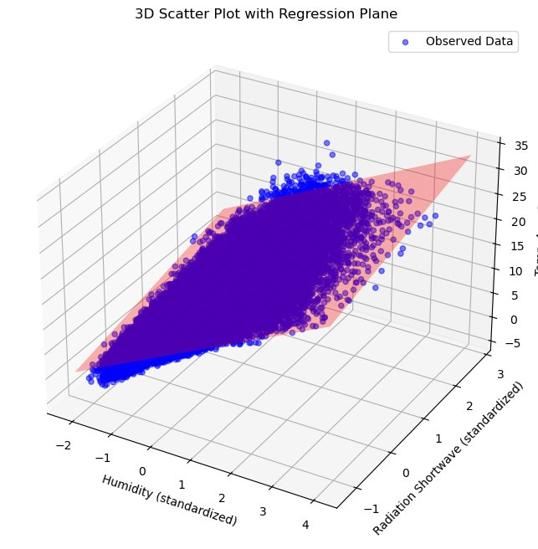
Multivariate Linear Regression
High Explained Variance
The model can account for approximately 93% of the variation in temperature, indicating a strong fit.
Low Multicolinearity
VIF values are all close to 1, suggesting that multicollinearity among predictors is minimal.
Further Exploration
More variables, Time series features...
Temp_Avg_C
Notes:
To improve our model, we now consider multiple variables in a multivariate linear regression.
The model has a high explained variance (93%), meaning it captures most of the variability in temperature.
Low multicollinearity is observed, with Variance Inflation Factor (VIF) values close to 1.
This indicates that the predictors are independent and useful for prediction.
Further exploration could include additional variables or time-series analysis.

Slide 13
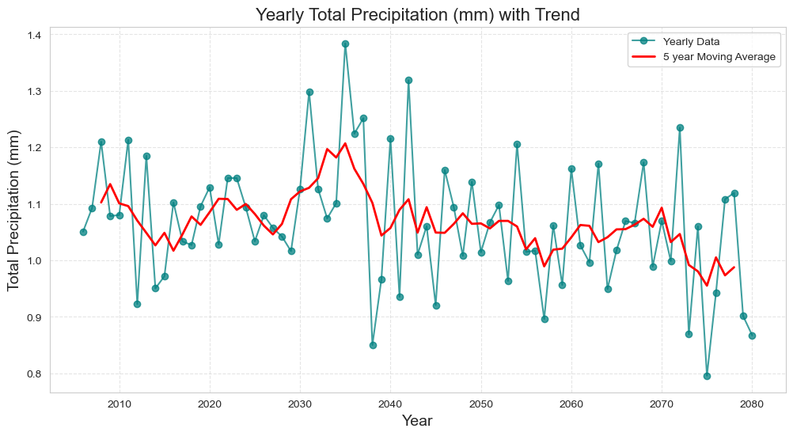
Summary
Temperature is the highest correlating factor with respect to several variables
Humidity and Shortwave Radiation may affect Temperature
Temperature projected to increase approximately 3 degrees Celsius on average between 2006-2080
More extreme weather events over time

Slide 14
Future Work
1. Use more features to increase the analysis accuracy
Air Quality（PM2.5， CO2 Levels, Ozone Levels）
Geographical(Elevation, Land Cover Type)
2. Modelling
Select feature
Correlation
Multicollinearity
Regression/deep learning
Random Forest Regression
Artificial Neural Network
Time Series Forecasting
3. Prediction
Temperature
Rainfall

Slide 15

Thank you for listening

